Slide 1
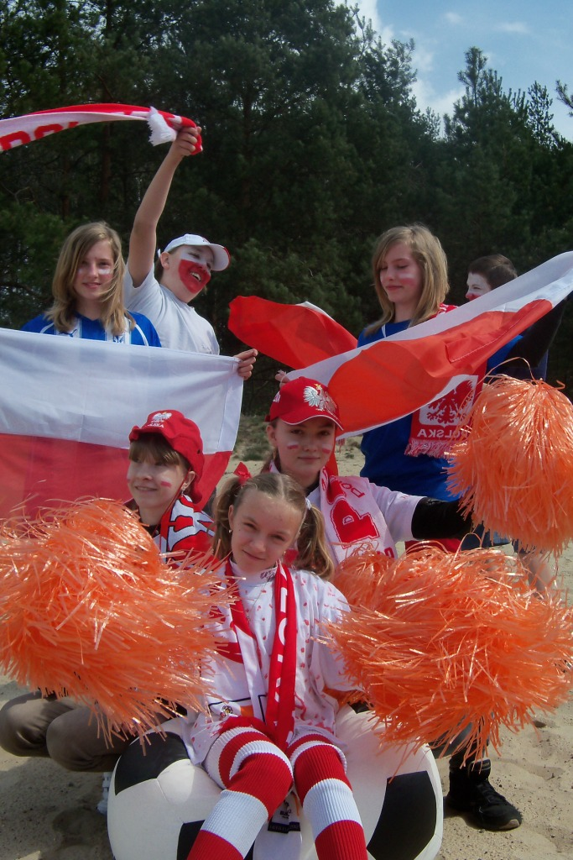
Grzegorzew – a unique place for eco–football fans!!!

Slide 2
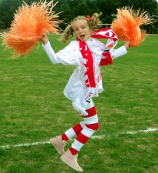
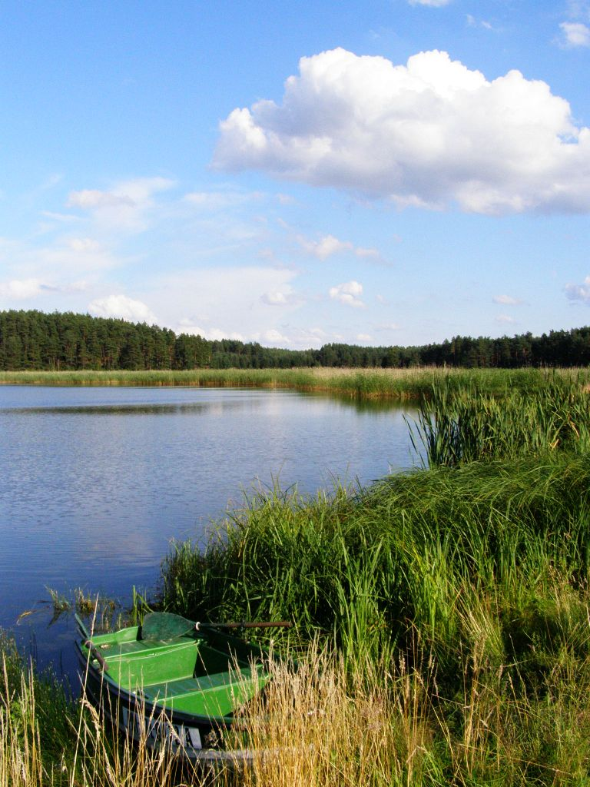
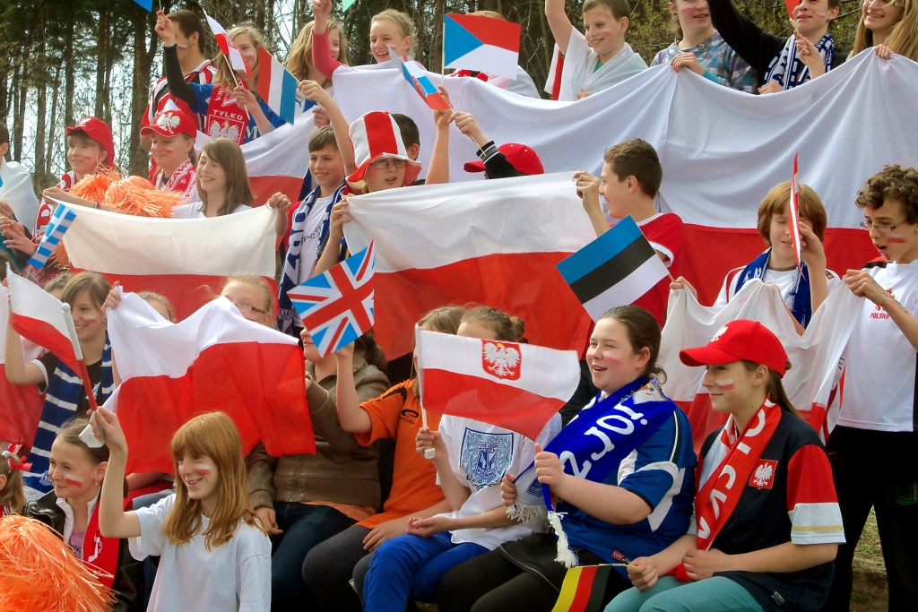
Why Grzegorzew?
Grzegorzew is the best place where you can both live and relax. It is full of lush meadows, clear lakes, picturesque ponds and hospitable people. All these mixed with Euro 2012 will give you an unforgettable experiences.

Slide 3
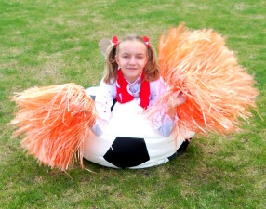
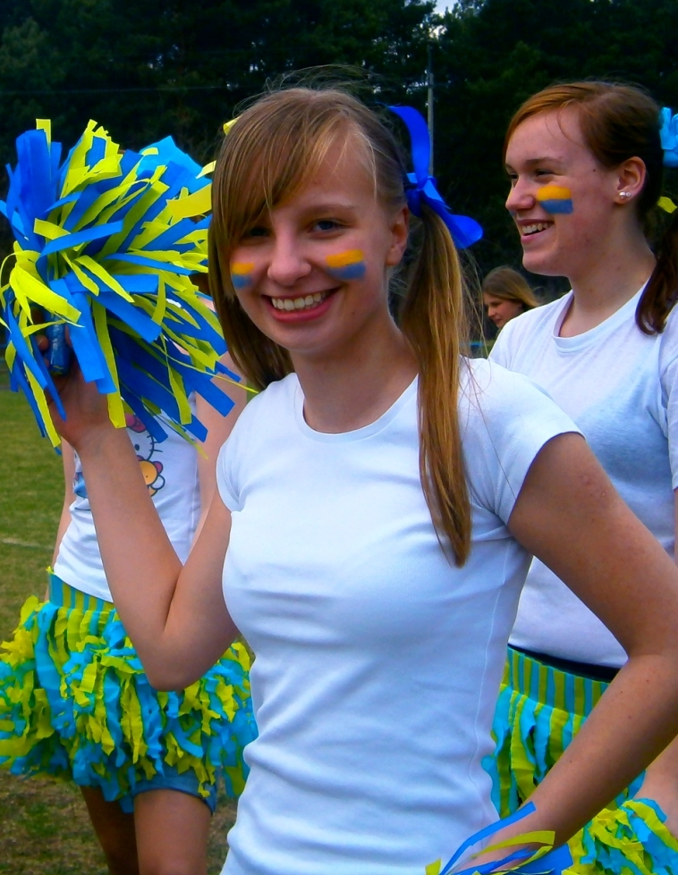
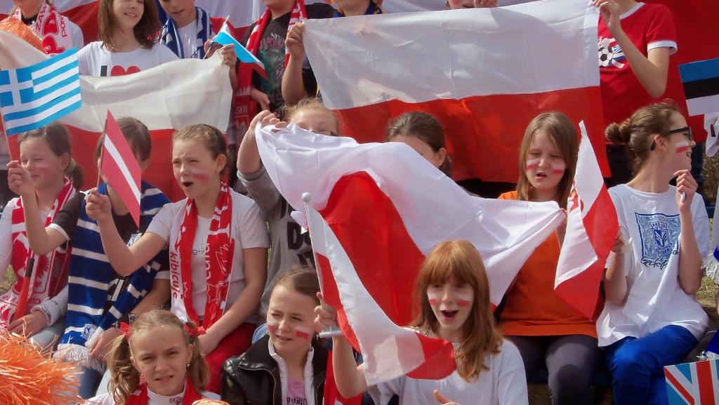
If you want to experience fantastic football emotion in the bosom of the nature – this place is perfect for you!!!
We`re planning that during the Euro 2012 there will be enormous screens on the local play ground and nearby meadows. The tickets will be free as there are lots of rich green grass to sit on. Our local football fans will help you to feel the atmosphere of Euro 2012. We will be with them cheering and playing the vuvuzelas. We have cheerleader's team too. Our beautiful girls will encourage fans to supporting.
.

Slide 4
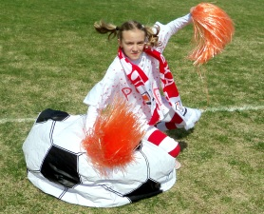
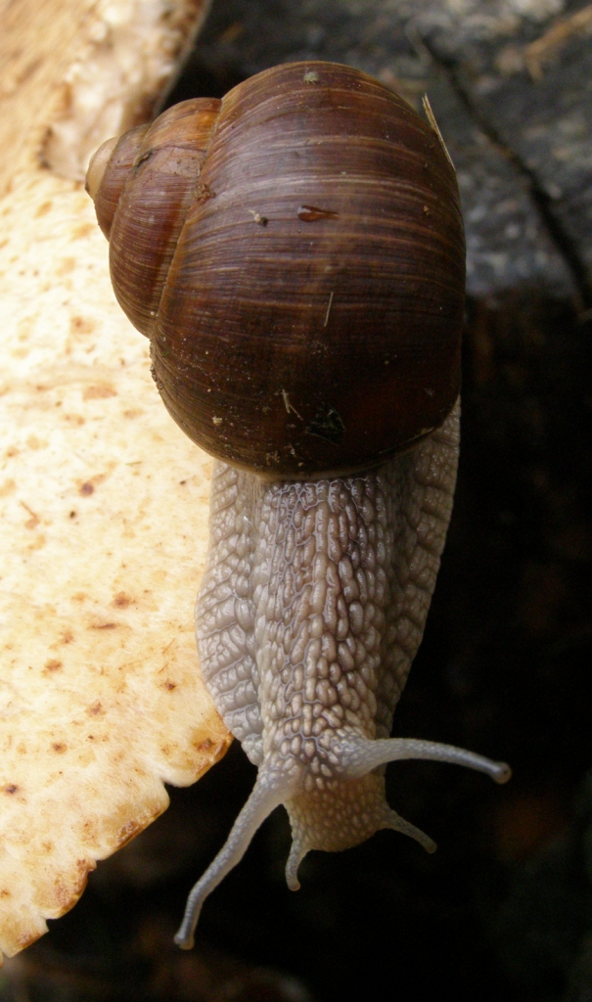
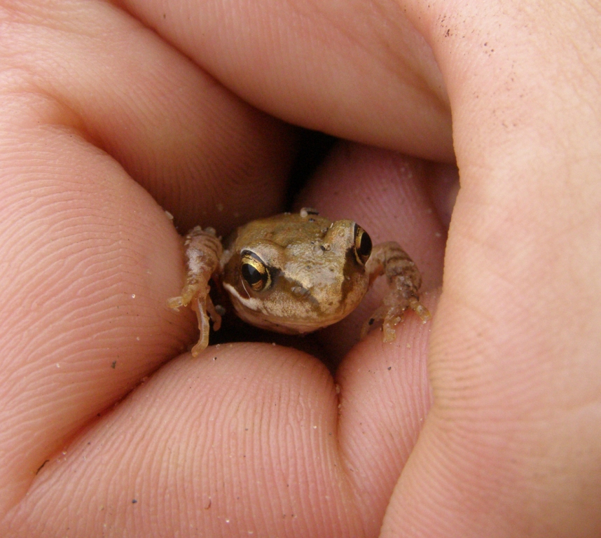
Are you a gambler?
Which football team are you going to bet on. Our smart and specially fed with delicate forget-me-nots snail will help you choose the winner, so you won’t loose your money.
The lucky girl or boy who will manage to score a goal during the break of the final match can kiss our magical frog, which turns into a beautiful prince or princes depending on the sex of the kisser. The happy couple will have the opportunity to have a bath in our incredible pond full of amazing water plants.

Slide 5
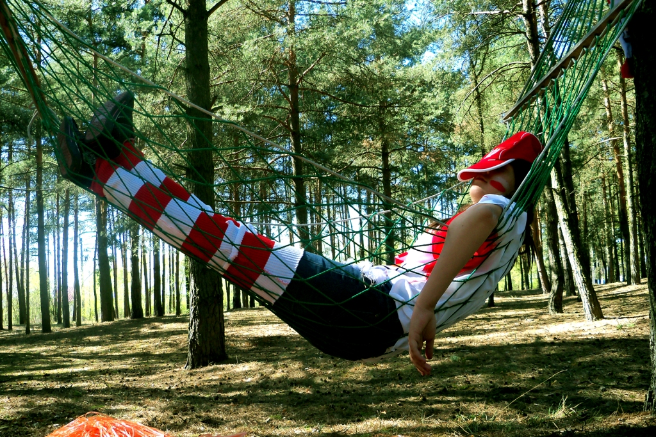
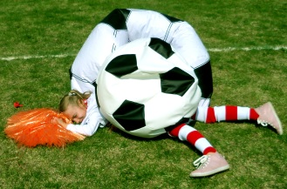
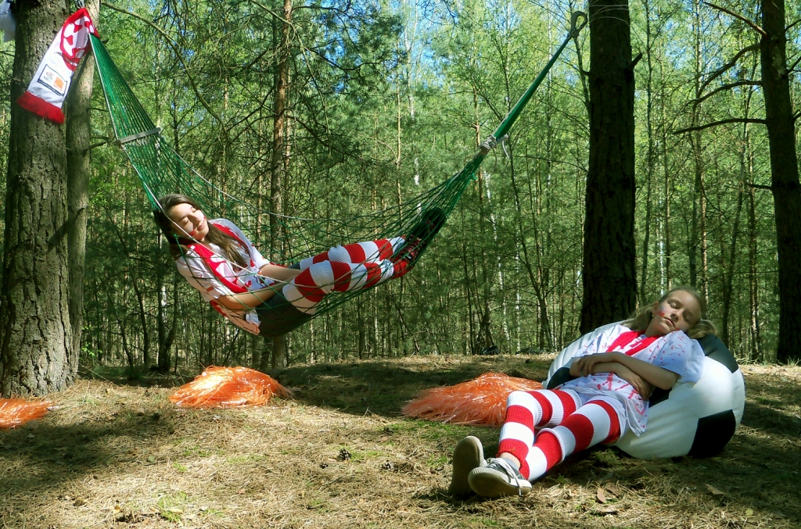
Tired or sleepy?
It`s OK. We have perfect conditions to relax - beautiful meadows, crystal clear streams and lakes. And what`s most important you don`t need to pay for a hotel. Our forest provides you a perfect place to sleep.

Slide 6
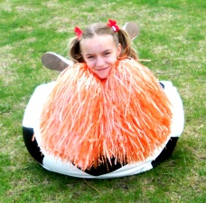
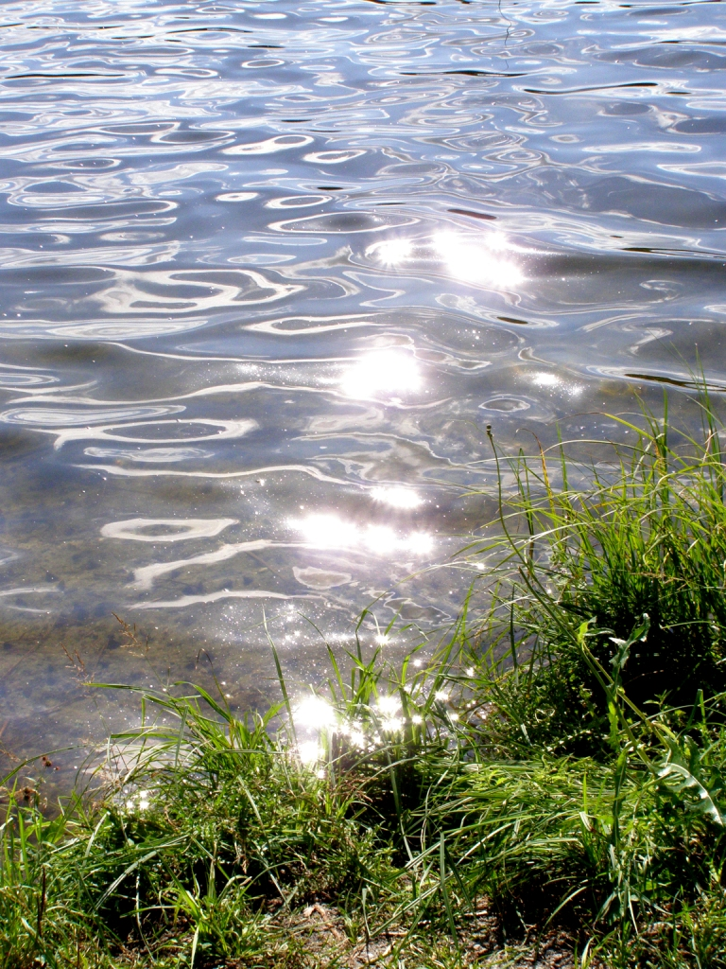
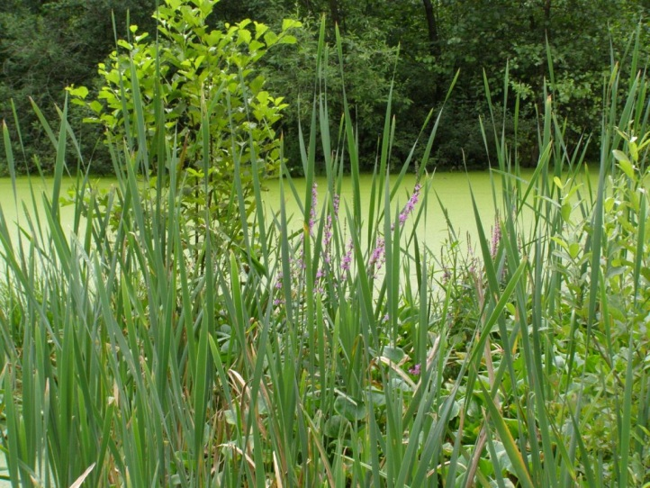
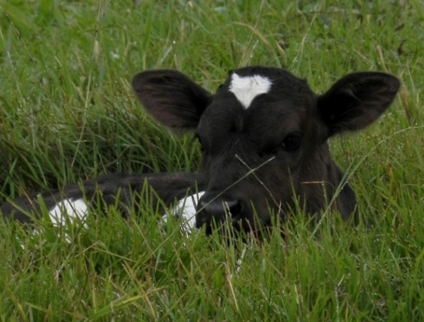
Dirty or hungry???
When you get up, you can help yourself to fresh and healthy milk, which is given by our friendly cows. You can find them waiting patiently on the meadows.
When you take a bath, you can use the gifts of the nature: herbal masks, crystal water to awake your skin and fresh air to feel your lungs and give you the power to survive next match.

Slide 7
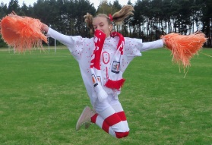
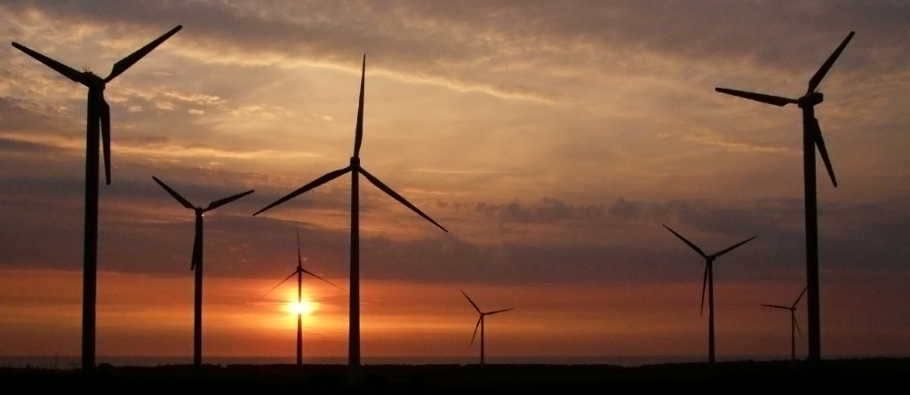
ECO-EURO 2012 only in Grzegorzew!
Our authorities care about the environment and we have won the eco competitions several times. We have windmills to produce eco–friendly energy to protect our nature. Thanks to these actions our surrounding is really worth seeing. We love spending time outside.

Slide 8
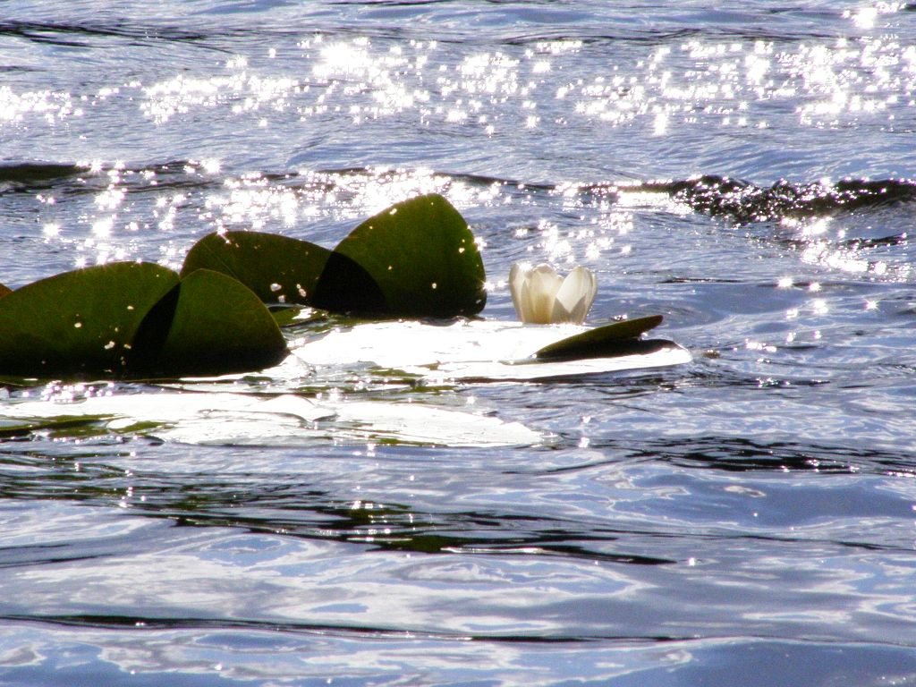
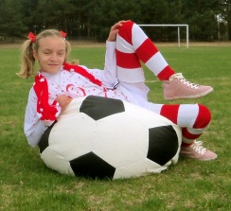
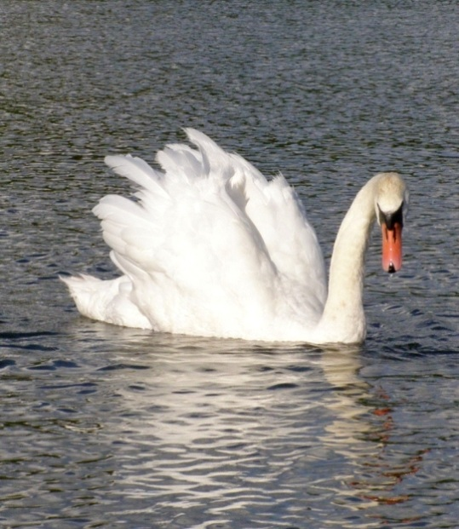
Feel the power of the nature!
Are you eco-football fan? – Then share your time between matches and nature.
Since matches are really stressful we’re going to relax in this way…

Slide 9
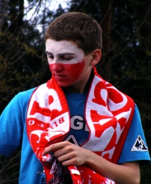
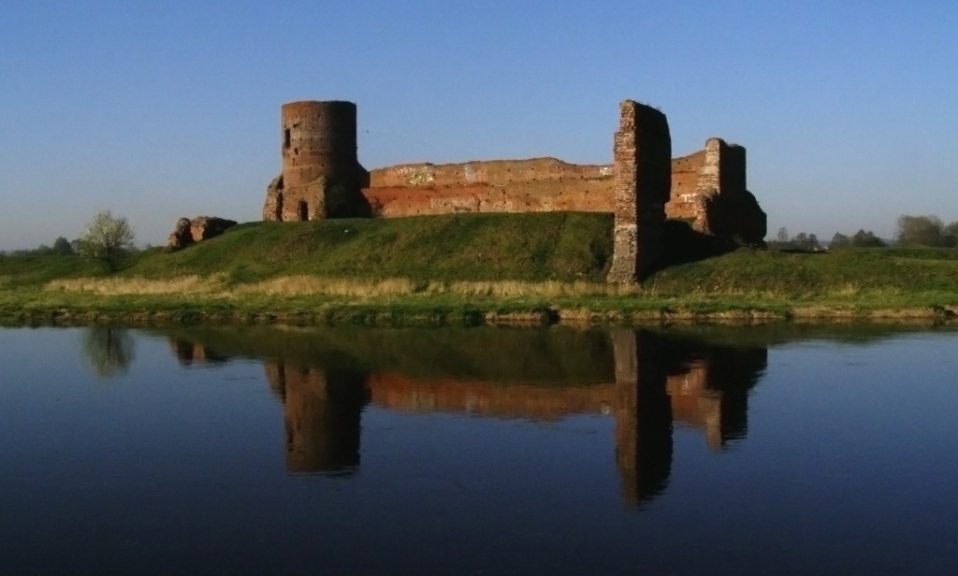
Are you bored waiting for next match? – See our historic castle!

Slide 10
The magic of the night.
The night can be orginal in Grzegorzew or nearby towns too.
If you aren’t sleepy and you like walking during the night you will see something really unique. The light in the night is a perfect painter so take a camera with you!

Slide 11
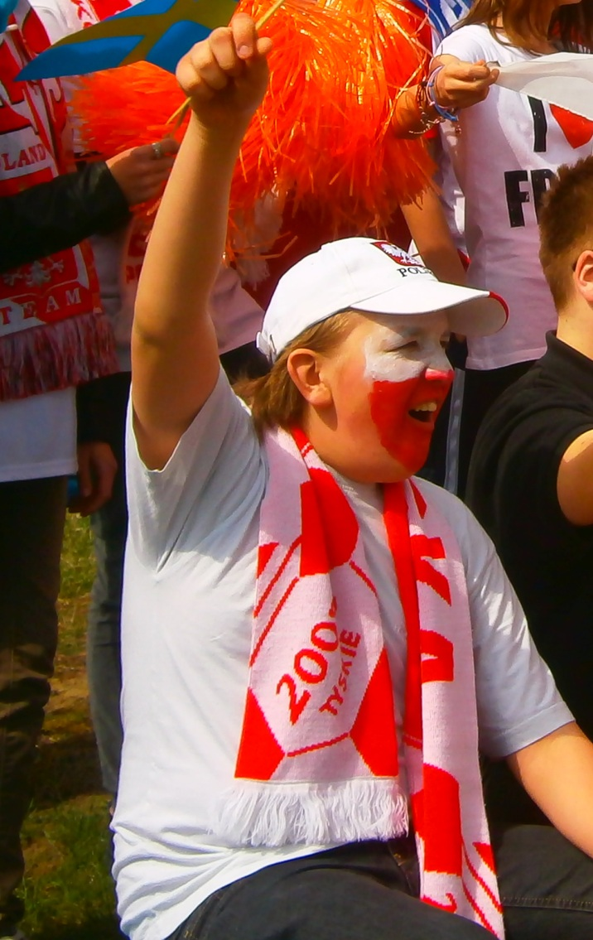
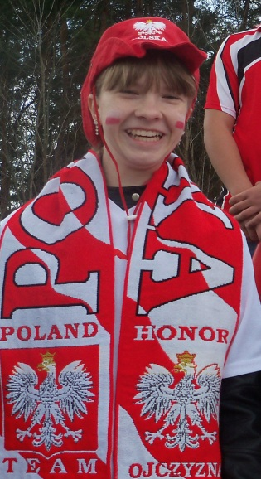
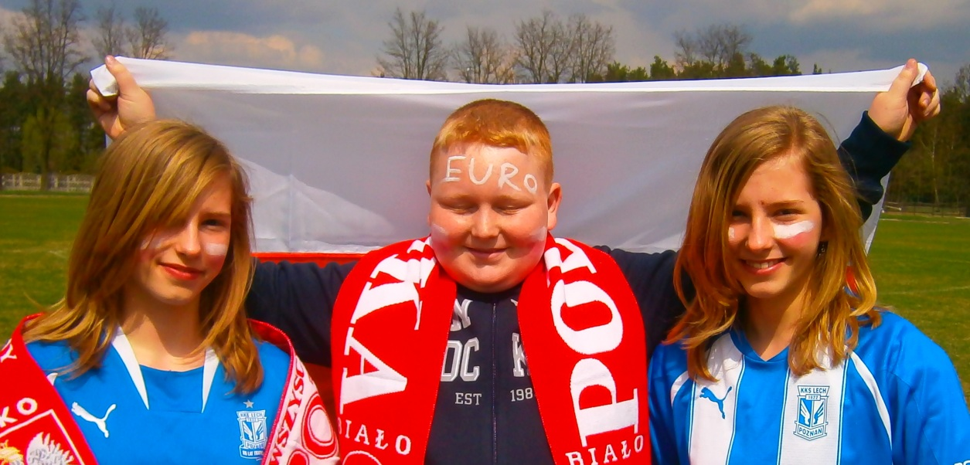
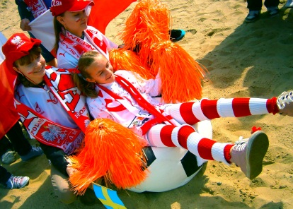
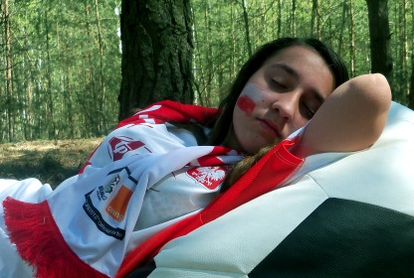
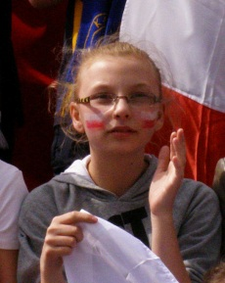
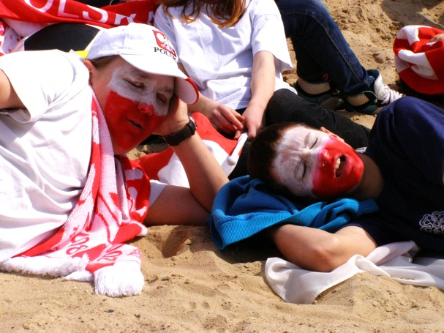
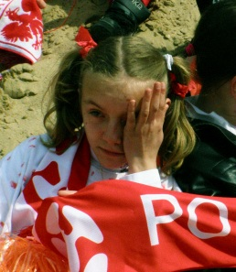
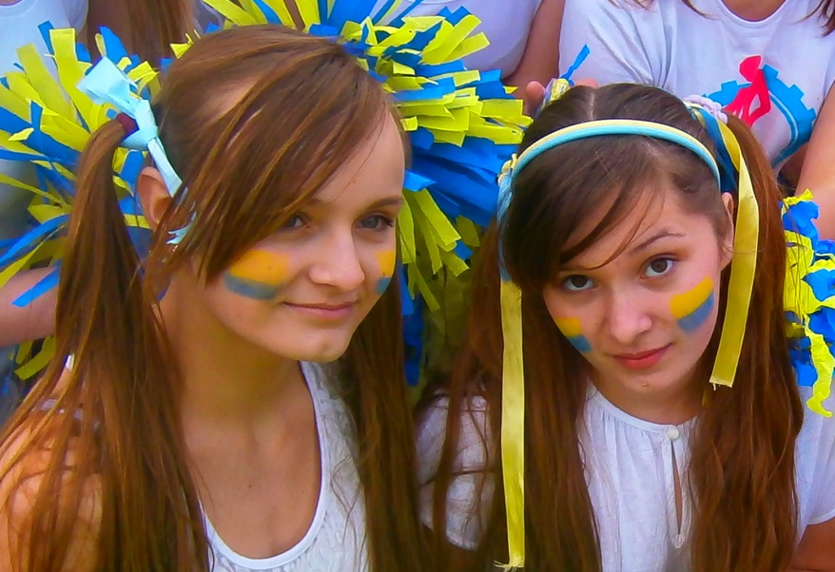
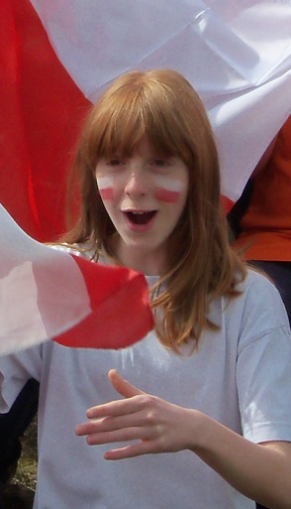
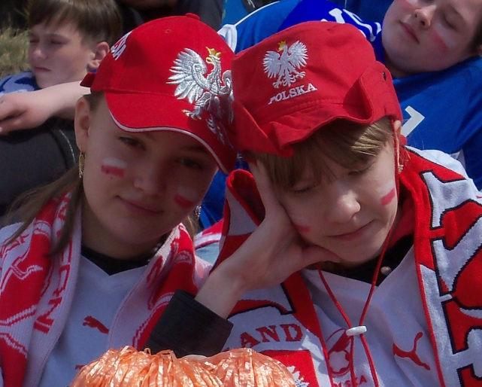
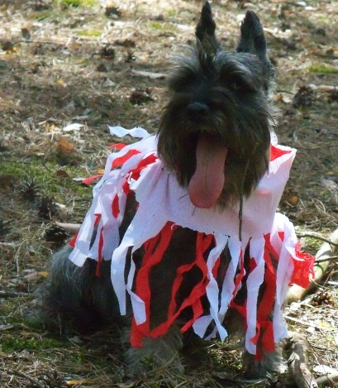
☺ Funny photos ☺

